Slide 1
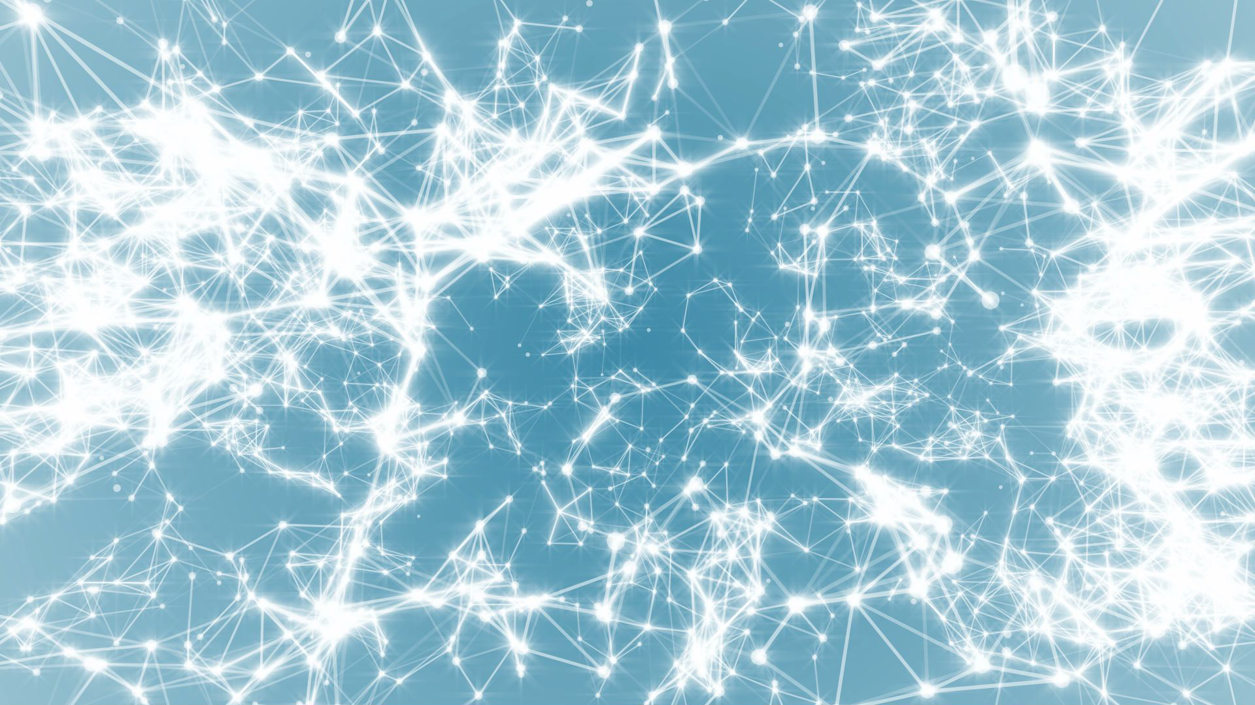
Frontiers of Network Science
Fall 2023
Class 9: Scale Free Networks and Barabasi Model II
(Chapters 4-5 in Textbook)
Boleslaw Szymanski
based on slides by Albert-László Barabási & Roberta Sinatra

Slide 2
Section 4
The meaning of scale-free
Network Science: Scale-Free Networks

Slide 3
Scale-free networks: Definition
Definition:
Networks with a power law tail in their degree distribution are called
‘scale-free networks’
Where does the name come from?
Critical Phenomena and scale-invariance
(a detour)
Slides after Dante R. Chialvo
Network Science: Scale-Free Networks
Slides after Dante R. Chialvo

Slide 4
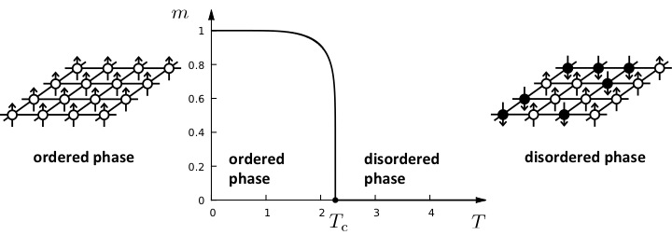

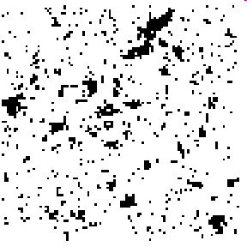
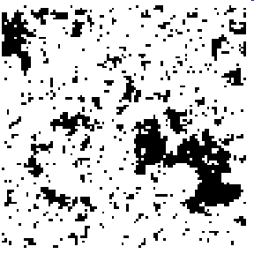
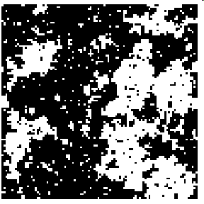
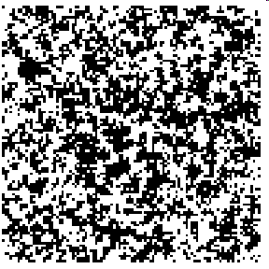
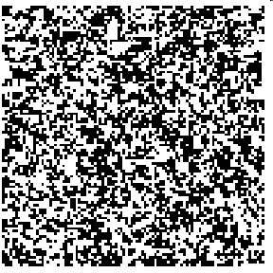

Phase transitions in complex systems I: Magnetism
T = 0.99 T_{c}
T = 0.999 T_{c}
T = T_{c}
T = 1.5 T_{c}
T = 2 T_{c}
ξ
ξ
Network Science: Scale-Free Networks

Slide 5
CRITICAL PHENOMENA
Correlation length diverges at the critical point: the whole system is correlated!
Scale invariance: there is no characteristic scale for the fluctuation (scale-free behavior).
Universality: exponents are independent of the system’s details.
Network Science: Scale-Free Networks
Notes:
Now we see where the ‘scale-free’ name comes from.
But what’s in the name?
We need to learn a bit more to understand that … soon
Before we get there, let us talk about universality.

Slide 6
Divergences in scale-free distributions
If m-γ+1<0:
If m-γ+1>0, the integral diverges.
For a fixed γ this means that all moments with m>γ-1 diverge.
Network Science: Scale-Free Networks

Slide 7
DIVERGENCE OF THE HIGHER MOMENTS
For a fixed γ this means all moments m>γ-1 diverge.
Network | N | L | 〈k〉 | 〈k_{in}²〉 | 〈k_{out}²〉 | 〈k²〉 | γ_{in} | γ_{out} | γ
Internet | 192,244 | 609,066 | 6.34 | - | - | 240.1 | - | - | 3.42*
WWW | 325,729 | 1,497,134 | 4.60 | 1546.0 | 482.4 | - | 2.00 | 2.31 | -
Power Grid | 4,941 | 6,594 | 2.67 | - | - | 10.3 | - | - | Exp.
Mobile-Phone Calls | 36,595 | 91,826 | 2.51 | 12.0 | 11.7 | - | 4.69* | 5.01* | -
Email | 57,194 | 103,731 | 1.81 | 94.7 | 1163.9 | - | 3.43* | 2.03* | -
Science Collaboration | 23,133 | 93,437 | 8.08 | - | - | 178.2 | - | - | 3.35*
Actor Network | 702,388 | 29,397,908 | 83.71 | - | - | 47,353.7 | - | - | 2.12*
Citation Network | 449,673 | 4,689,479 | 10.43 | 971.5 | 198.8 | - | 3.03* | 4.00* | -
E. Coli Metabolism | 1,039 | 5,802 | 5.58 | 535.7 | 396.7 | - | 2.43* | 2.90* | -
Protein Interactions | 2,018 | 2,930 | 2.90 | - | - | 32.3 | - | - | 2.89*-
Many degree exponents are smaller than 3
<k²> diverges in the N→∞ limit!!!
<k> diverges in the N→∞ limit!!!
Network Science: Scale-Free Networks

Slide 8
The meaning of scale-free
Network Science: Scale-Free Networks

Slide 9
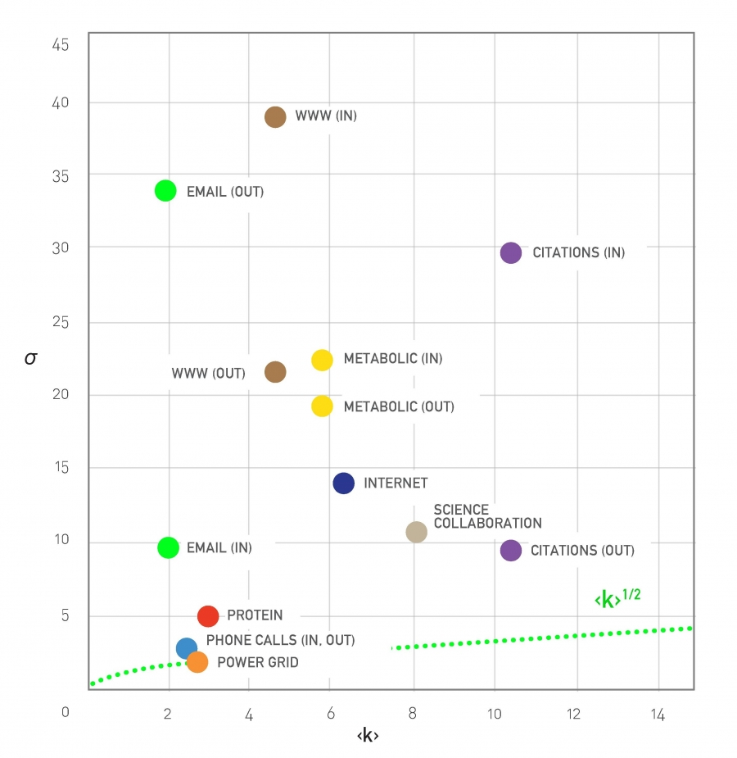
The meaning of scale-free
Network Science: Scale-Free Networks

Slide 10
Section 5
universality
Network Science: Scale-Free Networks

Slide 11
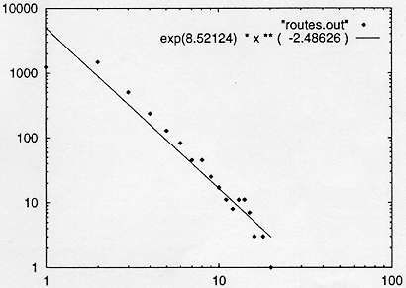
INTERNET BACKBONE
Nodes: computers, routers
Links: physical lines
(Faloutsos, Faloutsos and Faloutsos, 1999)
Network Science: Scale-Free Networks

Slide 12
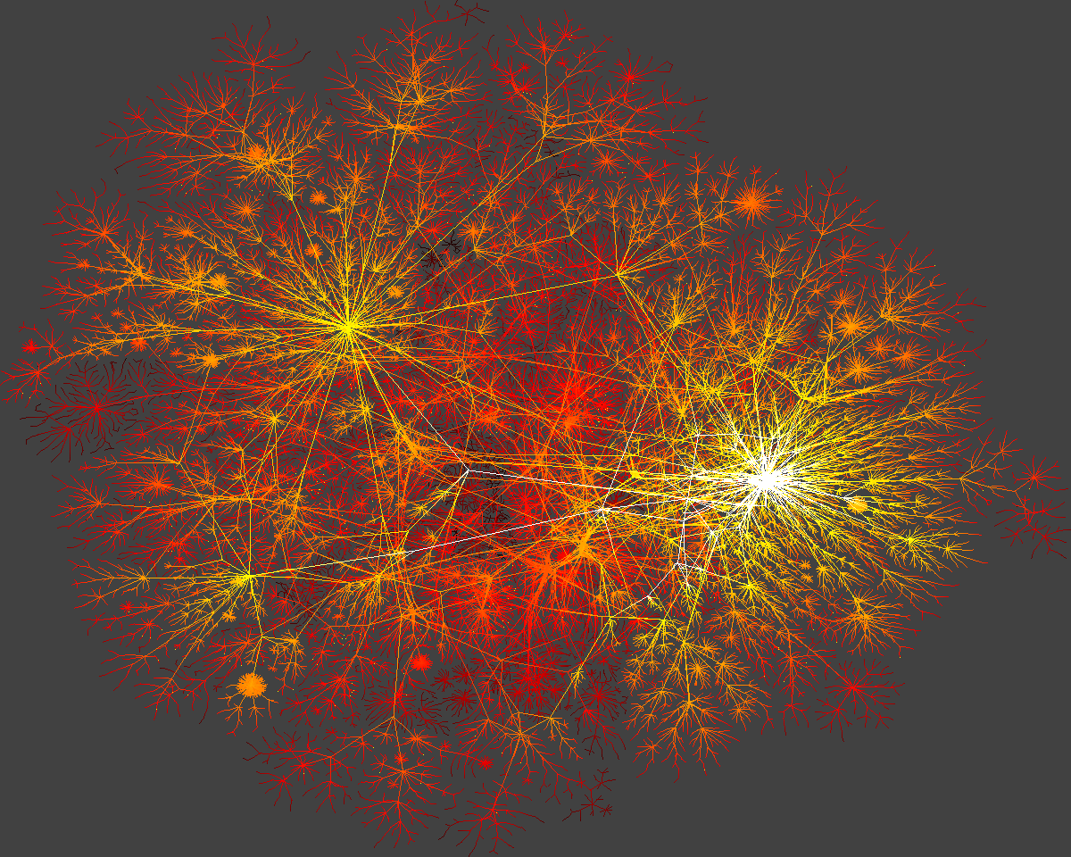
Network Science: Scale-Free Networks

Slide 13
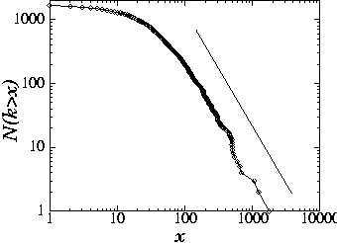
SCIENCE CITATION INDEX
Nodes: papers
Links: citations
25
H.E. Stanley,...
1736 PRL papers (1988)
578...
P(k) ~k^{-γ}
(γ = 3)
(S. Redner, 1998)
Network Science: Scale-Free Networks

Slide 14
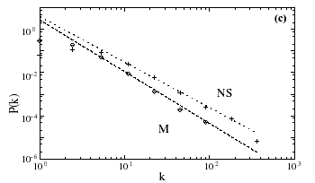
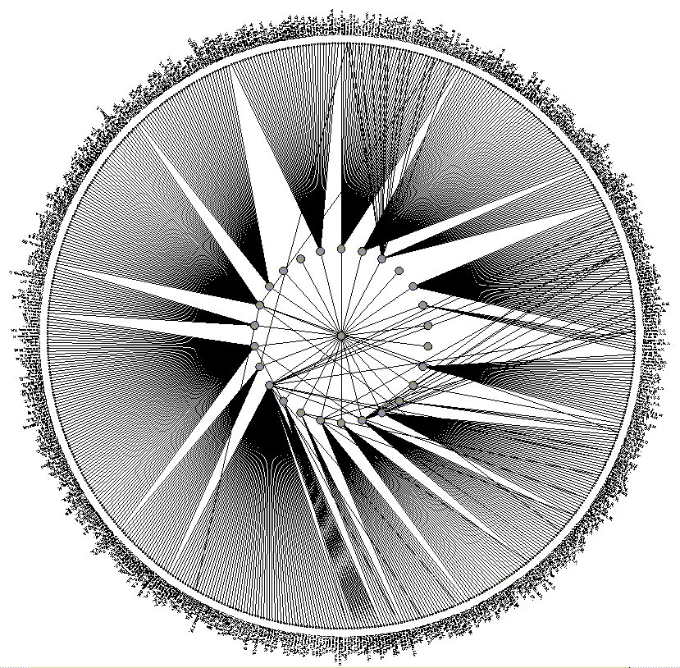
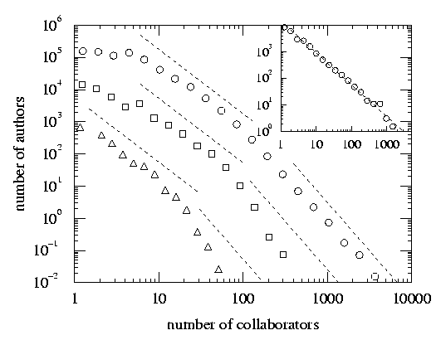
SCIENCE COAUTHORSHIP
Nodes: scientist (authors)
Links: joint publication
M: math
NS: neuroscience
(Newman, 2000, Barabasi et al 2001)
Network Science: Scale-Free Networks

Slide 15
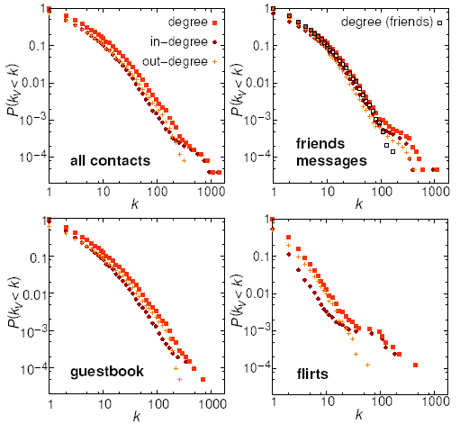
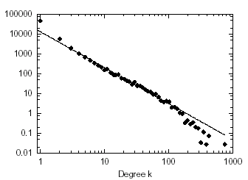
ONLINE COMMUNITIES
Nodes: online user
Links: email contact
Pussokram.com online community;
512 days, 25,000 users.
Kiel University log files
112 days, N=59,912 nodes
Ebel, Mielsch, Bornholdtz, PRE 2002.
Holme, Edling, Liljeros, 2002.
Network Science: Scale-Free Networks

Slide 16
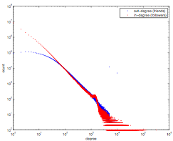
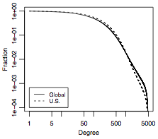
ONLINE COMMUNITIES
Twitter:
Facebook
Jake Hoffman, Yahoo,
Brian Karrer, Lars Backstrom, Cameron Marlowm ²⁰¹¹
Network Science: Scale-Free Networks
Notes:
FACEBOOK: The complementary cumulative distribution function (CCDF). The CCDF at degree k measures the fraction of users who have degree k or greater and in terms of the degree distribution is 􏰂k′ ≥k pk′ . For the U.S., the degree measures the number of friends also from the United States.

Slide 17
Section 2
Barabasi-Albert Model
Network Science: Scale-Free Networks

Slide 18
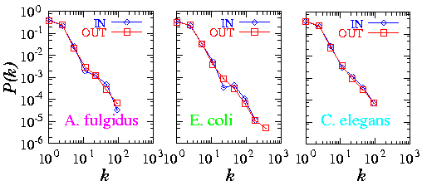
Meta-P(k)
METABOLIC NETWORK
Archaea
Bacteria
Eukaryotes
Organisms from all three domains of life are scale-free!
H. Jeong, B. Tombor, R. Albert, Z.N. Oltvai, and A.L. Barabasi, Nature, 407 651 (2000)
Network Science: Scale-Free Networks

Slide 19
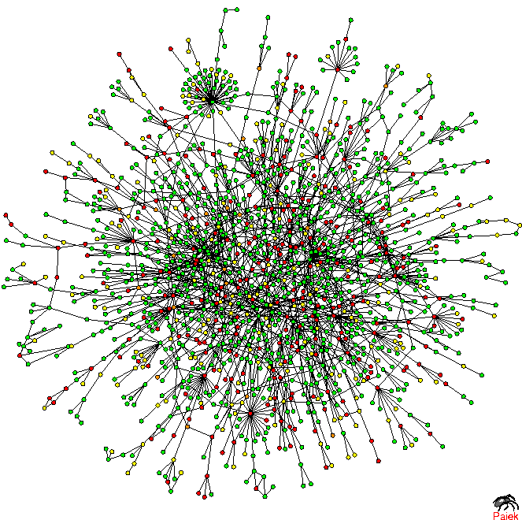
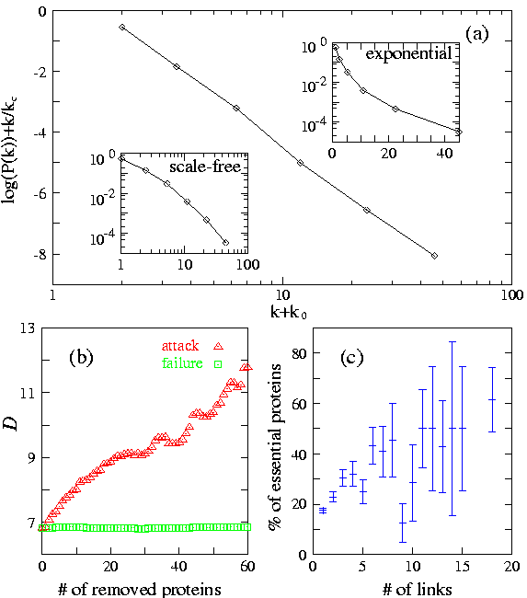
Prot P(k)
TOPOLOGY OF THE PROTEIN NETWORK
Nodes: proteins
Links: physical interactions-binding
H. Jeong, S.P. Mason, A.-L. Barabasi, Z.N. Oltvai, Nature 411, 41-42 (2001)

Slide 20
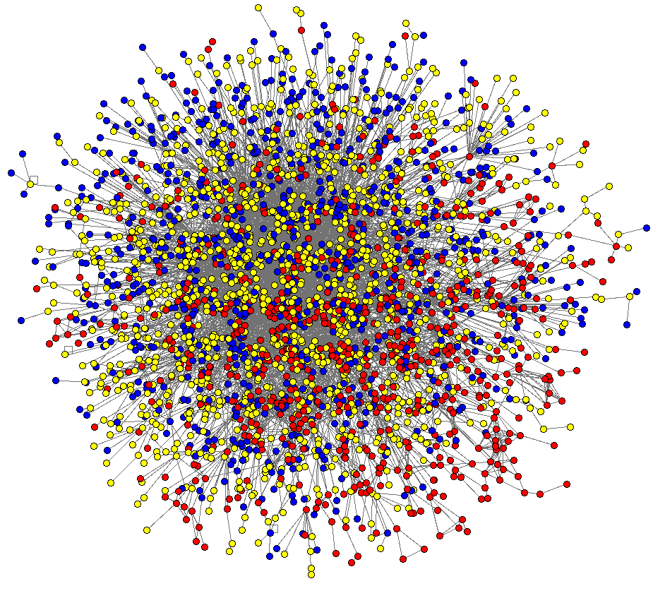
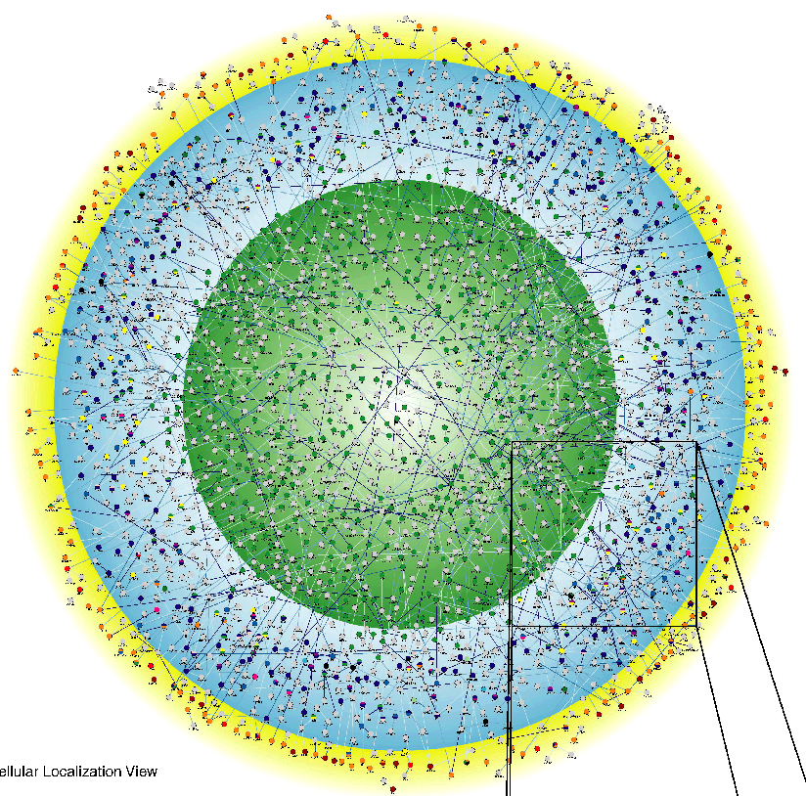
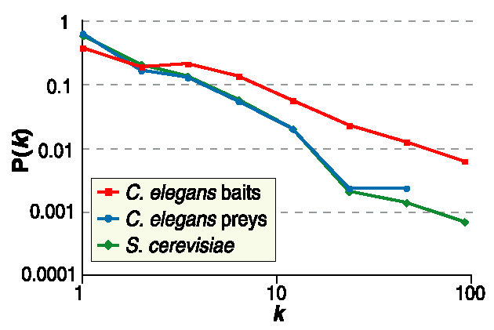
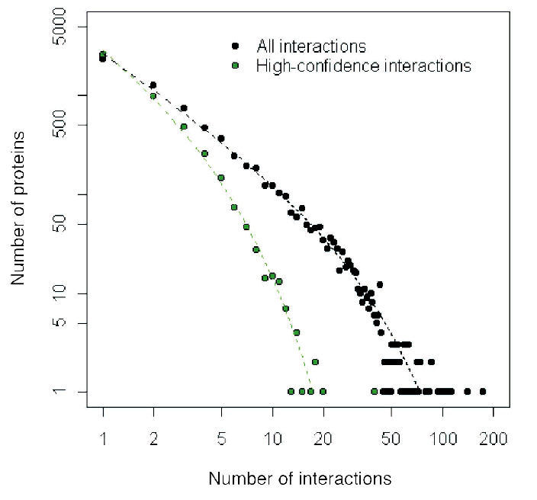
C. Elegans
Drosophila M.
Giot et al. Science 2003
Li et al. Science 2004
Network Science: Scale-Free Networks

Slide 21
Section 2
Growth and preferential attachment

Slide 22
Barabasi-Albert model Definition
The recognition that growth and preferential attachment coexist in real networks has
inspired a minimal model called the Barabási-Albert model (BA model), which
generates scale-free networks [1], defined as follows:
We start with m₀ nodes, the links between which are chosen arbitrarily, as long as each
node has at least one link. The network develops following two steps:
Growth: at each timestep we add a new node with m (≤ m₀) links that connect the
new node to m nodes already in the network.
Preferential attachment: the probability Π(k) that a link of the new node connects to
node i depends on the degree k_{i} as Π(k_{i})=k_{i}∑_{j} k_{j}
Preferential attachment is a probabilistic mechanism: a new node is free to connect to
any node in the network, whether it is a hub or has a single link. However, that if a new
node has a choice between a degree-two and a degree-four node, it is twice as likely that
it connects to the degree-four node.
[1] A.-L.Barabási, R. Albert and H. Jeong, Physica A 272, 173 (1999)
Network Science: Evolving Network Models
Notes:
PREDICTIONS:
(i) The degree exponent $\gamma$ is independent of $m$, a prediction that is in agreement with the numerical results (see Fig. 4).
(ii) As the power-law observed for real networks describes systems of rather different ages and sizes, it is expected that a correct model should provide a time-independent degree distribution. Indeed, Eq.(\ref{cube}) predicts that asymptotically (i.e. in the $t \gg m_0$ limit) the degree distribution of the BA model is independent of time (and, subsequently, independent of the system size $N=m_0+t$), indicating that despite its continuous growth, the network reaches a stationary scale-free state.
Nominal similarities shown in Figure 4 support these predictions.
(iii) Equation (\ref{cube}) indicates that the coefficient of the power-law distribution is proportional to $m^2$. a prediction again confirmed by the numerical simulations shown in Figure \ref{F-BA-BAScaling}.

Slide 23
Section 4 Linearized Chord Diagram
Possible evolution
paths with self-loops.
New node is red.
One possible definition with self-loops

Slide 24
Section 4
Degree dynamics

Slide 25
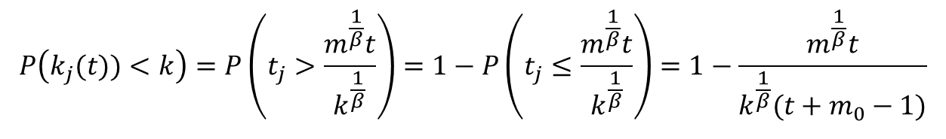
Degree distribution for Barabasi-Albert model
for t ≥ m₀+i and 0 otherwise as system size at t is N=m₀+t-1
We assume the initial m₀ nodes create a fully connected graph.
A random node j arriving at time t is with equal probability 1/N=1/(m₀+t-1) one of the nodes 1, 2,…. N, its degree will grow with the above equation, so
$$P\left(k_{j}(t))<k\right)=P\left(t_{j}>\frac{m^{\frac{1}{β}}t}{k^{\frac{1}{β}}}\right)=1−P\left(t_{j}≤\frac{m^{\frac{1}{β}}t}{k^{\frac{1}{β}}}\right)=1−\frac{m^{\frac{1}{β}}t}{k^{\frac{1}{β}}(t+m_{0}−1)}$$
For the large times t (and so large network sizes) we can replace t-1 with t above, so
γ = 3
A.-L.Barabási, R. Albert and H. Jeong, Physica A 272, 173 (1999)
Network Science: Evolving Network Models
Notes:
PREDICTIONS:
(i) The degree exponent $\gamma$ is independent of $m$, a prediction that is in agreement with the numerical results (see Fig. 4).
(ii) As the power-law observed for real networks describes systems of rather different ages and sizes, it is expected that a correct model should provide a time-independent degree distribution. Indeed, Eq.(\ref{cube}) predicts that asymptotically (i.e. in the $t \gg m_0$ limit) the degree distribution of the BA model is independent of time (and, subsequently, independent of the system size $N=m_0+t$), indicating that despite its continuous growth, the network reaches a stationary scale-free state.
Nominal similarities shown in Figure 4 support these predictions.
(iii) Equation (\ref{cube}) indicates that the coefficient of the power-law distribution is proportional to $m^2$. a prediction again confirmed by the numerical simulations shown in Figure \ref{F-BA-BAScaling}.

Slide 26
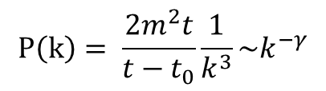
Degree distribution
$$P\left(k\right)= \frac{2m^{2}t}{t−t_{0}}\frac{1}{k^{3}}\sim k^{−γ}$$
γ = 3
(i) The degree exponent is independent of m.
(ii) As the power-law describes systems of rather different ages and sizes, it is expected that a correct model should provide a time-independent degree distribution. Indeed, asymptotically the degree distribution of the BA model is independent of time (and of the system size N)
→ the network reaches a stationary scale-free state.
(iii) The coefficient of the power-law distribution is proportional to m².
A.-L.Barabási, R. Albert and H. Jeong, Physica A 272, 173 (1999)
Network Science: Evolving Network Models
Notes:
PREDICTIONS:
(i) The degree exponent $\gamma$ is independent of $m$, a prediction that is in agreement with the numerical results (see Fig. 4).
(ii) As the power-law observed for real networks describes systems of rather different ages and sizes, it is expected that a correct model should provide a time-independent degree distribution. Indeed, Eq.(\ref{cube}) predicts that asymptotically (i.e. in the $t \gg m_0$ limit) the degree distribution of the BA model is independent of time (and, subsequently, independent of the system size $N=m_0+t$), indicating that despite its continuous growth, the network reaches a stationary scale-free state.
Nominal similarities shown in Figure 4 support these predictions.
(iii) Equation (\ref{cube}) indicates that the coefficient of the power-law distribution is proportional to $m^2$. a prediction again confirmed by the numerical simulations shown in Figure \ref{F-BA-BAScaling}.

Slide 27
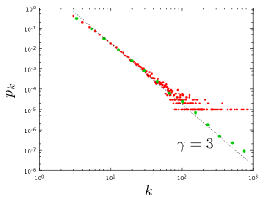
Section 4
Notes:
The degree distribution of a network generated by the Barabási-Albert model. The plot show for a single network of size N=100,000 and m=3 and . It shows both the linearly-binned (red symbols) as well as the log-binned version (green symbols) o. The straight line is added to guide the eye and has slope -3, corresponding to the resulting network’s degree exponent.

Slide 28
NUMERICAL SIMULATION OF THE BA MODEL

Slide 29
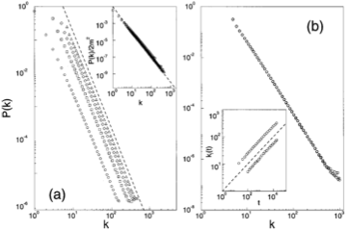

NUMERICAL SIMULATION OF THE BA MODEL
m=1,3,5,7
N=100,000;150,000;200,000
m-dependence
Stationarity:
P(k) independent of N
Insert:
degree dynamics
Network Science: Evolving Network Models

Slide 30
The mean field theory offers the correct scaling, BUT it provides the wrong coefficient of the degree distribution.
So assymptotically it is correct (k→ ∞), but not correct in details (particularly for small k).
To fix it, we need to calculate P(k) exactly, which we will do next using a rate equation based approach.
Network Science: Evolving Network Models

Slide 31
MFT - Degree Distribution: Rate Equation
Number of nodes with degree k at time t.
Since at each timestep we add one node, we have N=t (total number of nodes = number of timesteps)
2m: each node adds m links, but each link contributed to the degree of 2 nodes
Total number of k-nodes
Number of links added to degree k nodes after the arrival of a new node:
Nr. of degree k-1 nodes that acquire a new link, becoming degree k
New node adds m new links to other nodes
Preferential attachment
Nr. of degree k nodes that acquire a new link, becoming degree k+1
# k-nodes at time t+1
# k-nodes at time t
Gain of k-nodes via
k-1→ k
Loss of k-nodes via
k→ k+1
A.-L.Barabási, R. Albert and H. Jeong, Physica A 272, 173 (1999)

Slide 32
MFT - Degree Distribution: Rate Equation
# k-nodes at time t+1
# k-nodes at time t
Gain of k-nodes via
k-1→ k
Loss of k-nodes via
k→ k+1
We do not have k=0,1,...,m-1 nodes in the network (each node arrives with degree m)
→ We need a separate equation for degree m modes
# m-nodes at time t+1
# m-nodes at time t
Add one
m-degeree node
Loss of an
m-node via
m→ m+1
A.-L.Barabási, R. Albert and H. Jeong, Physica A 272, 173 (1999)
Network Science: Evolving Network Models

Slide 33
MFT - Degree Distribution: Rate Equation
k>m
We assume that there is a stationary state in the N=t→∞ limit, when P(k,∞)=P(k)
k>m
Network Science: Evolving Network Models

Slide 34
MFT - Degree Distribution: Rate Equation
➔
m+3 → k
...
for large k
Krapivsky, Redner, Leyvraz, PRL 2000
Dorogovtsev, Mendes, Samukhin, PRL 2000
Bollobas et al, Random Struc. Alg. 2001
Network Science: Evolving Network Models

Slide 35
MFT - Degree Distribution: A Pretty Caveat
Start from eq.
Its solution is:
Dorogovtsev and Mendes, 2003
Network Science: Evolving Network Models

Slide 36
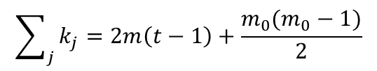
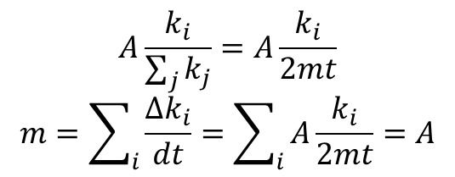
All nodes follow the same growth law
$$A\frac{k_{i}}{\sum_{j}{k_{j}}}=A\frac{k_{i}}{2mt}$$
$$m=\sum_{i}{\frac{∆k_{i}}{dt}}=\sum_{i}{A\frac{k_{i}}{2mt}=A}$$
In limit:
So:
$$\sum_{j}{k_{j}=2m\left(t−1\right)+\frac{m_{0}(m_{0}−1)}{2}}$$
Use:
During a unit time (time step): Δk=m → A=m
β: dynamical exponent
A.-L.Barabási, R. Albert and H. Jeong, Physica A 272, 173 (1999)
Network Science: Evolving Network Models
Notes:
This is an important prediction, as it implies that all nodes follow the same growth law. Hence the difference between the hubs is not in the fact that hubs grow faster, but that they are older. Indeed, the difference between the nodes comes in the intercept of the power-law, controlled by $t_i$, representing the time at which node $i$ joined the network.
If all nodes follow the same growth rate, why do we have hubs and less connected nodes in the network? The reason is that at moment older nodes have a higher degree according to Eq. \ref{connect}--indeed, the smaller $t_i$ is, the higher is the node's degree. As a consequence older nodes acquire more links in an unit time. This is seen by inspective the derivative of Eq. \ref{connect}, which is nothing but the node's growth rate (i.e. the rate at which the node acquires new links)
with predicts two things. First, it tells is that the older the node is (i.e. the smaller $t_i$ is), the larger the growth rate. Second, it also tells us that with time the rate at which the nodes acquire links goes down, thanks to the fact that the new nodes have many more nodes to link to.

